Slide 1
Subnetting Practice Week
Week 8
Dr. Farshid Keivanian

Slide 2
Today we practise IPv4 subnetting.
By the end of this class, you should be able to:
identify the subnet mask and prefix
calculate network and broadcast addresses
find first and last usable host addresses
calculate the number of usable hosts
calculate the number of created subnets
solve AT2-style subnetting problems
3
Presentation_ID
© 2008 Cisco Systems, Inc. All rights reserved.

Slide 3
Today we practise IPv4 subnetting.
Key idea:
This week is mainly about solving problems, not learning many new concepts.
Australian example:
Imagine you are designing IP networks for different departments in an Australian university campus.
3
Presentation_ID
© 2008 Cisco Systems, Inc. All rights reserved.

Slide 4
Why Are We Practising Subnetting?
Subnetting is used to divide one large IP network into smaller networks.
This helps us:
organise devices
reduce unnecessary broadcast traffic
use IP addresses efficiently
separate departments or locations
design scalable networks
3
Presentation_ID
© 2008 Cisco Systems, Inc. All rights reserved.

Slide 5
Why Are We Practising Subnetting?
Australian example:
An Australian university might use separate subnets for:
Student Labs
Staff Offices
Library
Wi-Fi
Security Cameras
3
Presentation_ID
© 2008 Cisco Systems, Inc. All rights reserved.

Slide 6
Why Are We Practising Subnetting?
Discussion question:
Why not place every device in one very large network?
Because a large network creates more broadcast traffic and is harder to manage.
3
Presentation_ID
© 2008 Cisco Systems, Inc. All rights reserved.

Slide 7
Connection to Assessment Task 2
AT2 – VLSM Subnetting
Assessment Task 2 requires you to apply IPv4 subnetting and Variable Length Subnet Masking (VLSM) skills to a realistic network scenario.
For each network segment, you may need to determine:
the required number of usable hosts;
the appropriate prefix length (for example, /23, /24 or /26);
3
Presentation_ID
© 2008 Cisco Systems, Inc. All rights reserved.

Slide 8
Connection to Assessment Task 2
the subnet mask;
the network address;
the first usable host address;
the last usable host address;
the broadcast address; and
an efficient allocation of the available IP address space.
3
Presentation_ID
© 2008 Cisco Systems, Inc. All rights reserved.

Slide 9
Connection to Assessment Task 2
Important:
You need to show your calculations.
Do not only write the final answer.
Discussion question:
Why should you show your working in AT2?
Because the calculation demonstrates that you understand how the answer was obtained.
3
Presentation_ID
© 2008 Cisco Systems, Inc. All rights reserved.

Slide 10
Connection to Assessment Task 2
When using VLSM, remember to allocate the networks from the largest host requirement to the smallest and make sure that the allocated subnets do not overlap and remain within the given address block.
3
Presentation_ID
© 2008 Cisco Systems, Inc. All rights reserved.

Slide 11
Connection to Assessment Task 2
Important) Show your calculations and working clearly.
Do not simply write the final addresses in the table. Your working should demonstrate how you determined the appropriate subnet size, prefix length and address range.
Discussion Question) Why is it important to show your working in AT2?
3
Presentation_ID
© 2008 Cisco Systems, Inc. All rights reserved.

Slide 12
Connection to Assessment Task 2
Because the calculations demonstrate that you understand how the subnet size and address range were determined, rather than simply providing a final answer. Clear working also makes it possible to check your subnetting process and identify any mistakes.
3
Presentation_ID
© 2008 Cisco Systems, Inc. All rights reserved.

Slide 13
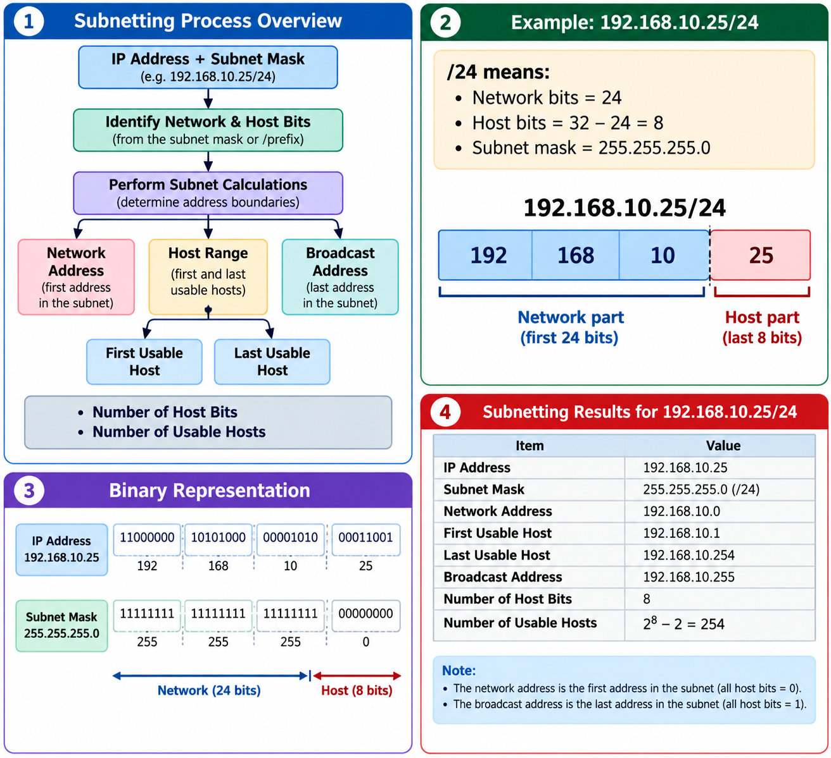
What Information Can We Find?
3
Presentation_ID
© 2008 Cisco Systems, Inc. All rights reserved.

Slide 14
What Information Can We Find?
3
Presentation_ID
© 2008 Cisco Systems, Inc. All rights reserved.

Slide 15
What Information Can We Find?
3
Presentation_ID
© 2008 Cisco Systems, Inc. All rights reserved.

Slide 16
What Information Can We Find?
3
Presentation_ID
© 2008 Cisco Systems, Inc. All rights reserved.

Slide 17
Four Questions to Think About
Try these before we continue.
Question 1
A network uses /28.
How many usable hosts can it support?
Answer: 14
3
Presentation_ID
© 2008 Cisco Systems, Inc. All rights reserved.

Slide 18
Four Questions to Think About
Question 2
How many bits must be borrowed to create at least 5 subnets?
2² = 4 not enough
2³ = 8 enough
Answer: 3 bits
3
Presentation_ID
© 2008 Cisco Systems, Inc. All rights reserved.

Slide 19
Four Questions to Think About
Question 3
How many usable hosts are available with:
255.255.255.248
This is /29.
Host bits = 3
2³ - 2 = 6
Answer: 6 usable hosts
3
Presentation_ID
© 2008 Cisco Systems, Inc. All rights reserved.

Slide 20
Four Questions to Think About
Question 4
What prefix is:
255.255.255.224
Answer: /27
3
Presentation_ID
© 2008 Cisco Systems, Inc. All rights reserved.

Slide 21
IPv4 Addresses Have 32 Bits
An IPv4 address contains: 32 bits
It is divided into four groups.
Each group contains: 8 bits
Each group is called an octet.
Example: 192.168.10.25 has four octets:
192 | 168 | 10 | 25
Discussion question:
How many bits are in one IPv4 octet?
Answer: 8 bits.
3
Presentation_ID
© 2008 Cisco Systems, Inc. All rights reserved.

Slide 22
Binary Values Inside One Octet
Remember the binary positions:
128 64 32 16 8 4 2 1
If the bit is 1, include the value.
If the bit is 0, ignore the value.
Example: 11000000
means:
128 + 64 = 192
Therefore:
11000000 = 192
3
Presentation_ID
© 2008 Cisco Systems, Inc. All rights reserved.

Slide 23
Quick Binary Practice
Convert: 11100000
Use:
128 + 64 + 32
Result:
224
Discussion question:
What is 11110000 in decimal?
Answer:
128 + 64 + 32 + 16 = 240
3
Presentation_ID
© 2008 Cisco Systems, Inc. All rights reserved.

Slide 24
Important Subnet Mask Values
Memorise this pattern:
Binary | Decimal
00000000 | 0
10000000 | 128
11000000 | 192
11100000 | 224
11110000 | 240
11111000 | 248
11111100 | 252
11111110 | 254
11111111 | 255
These values appear frequently in subnetting.
3
Presentation_ID
© 2008 Cisco Systems, Inc. All rights reserved.

Slide 25
Prefix Length Review
The prefix tells us how many bits belong to the network.
Example:
/24
means:
24 network bits
8 host bits
because:
32 - 24 = 8
3
Presentation_ID
© 2008 Cisco Systems, Inc. All rights reserved.

Slide 26
Prefix and Mask Examples
/24 = 255.255.255.0
/25 = 255.255.255.128
/26 = 255.255.255.192
/27 = 255.255.255.224
/28 = 255.255.255.240
/29 = 255.255.255.248
/30 = 255.255.255.252
Discussion question) What is the subnet mask for /27?
Answer) 255.255.255.224
3
Presentation_ID
© 2008 Cisco Systems, Inc. All rights reserved.

Slide 27
Network Bits vs Host Bits
Every IPv4 address contains two logical parts:
Network portion | Host portion
The subnet mask tells us where the division occurs.
Example:
192.168.10.25/24
can be viewed as:
Network: 192.168.10
Host: 25
3
Presentation_ID
© 2008 Cisco Systems, Inc. All rights reserved.

Slide 28
Australian Example: University Lab
Suppose ACU has: 192.168.40.0/24
for a computer laboratory.
Possible devices:
192.168.40.10
192.168.40.20
192.168.40.50
All belong to the same /24 network.
3
Presentation_ID
© 2008 Cisco Systems, Inc. All rights reserved.

Slide 29
Australian Example: University Lab
Discussion question:
Would 192.168.41.20/24 be in the same subnet?
No. Its network would be 192.168.41.0/24.
3
Presentation_ID
© 2008 Cisco Systems, Inc. All rights reserved.

Slide 30
The Two Special Addresses
In a traditional IPv4 subnet, two addresses are normally not assigned to hosts.
Network address
The first address.
Example: 192.168.10.0
Broadcast address
The last address.
Example: 192.168.10.255
for /24.
3
Presentation_ID
© 2008 Cisco Systems, Inc. All rights reserved.

Slide 31
Usable Host Range
For: 192.168.10.0/24
we have:
Network: 192.168.10.0
First host: 192.168.10.1
Last host: 192.168.10.254
Broadcast: 192.168.10.255
Discussion question) Can we assign 192.168.10.255 to a PC?
Answer: No. It is the broadcast address.
3
Presentation_ID
© 2008 Cisco Systems, Inc. All rights reserved.

Slide 32
Host Calculations
Use:
2^h - 2
where:
h = number of host bits
We subtract 2 for:
Network address
Broadcast address
3
Presentation_ID
© 2008 Cisco Systems, Inc. All rights reserved.

Slide 33
Example: /28
For /28:
32 - 28 = 4 host bits
Possible addresses:
2⁴ = 16
Usable hosts:
16 - 2 = 14
Therefore:
/28 → 14 usable hosts
3
Presentation_ID
© 2008 Cisco Systems, Inc. All rights reserved.

Slide 34
Practice: /27
For /27:
Host bits = 32 - 27
= 5
2⁵ = 32 addresses
32 - 2 = 30 usable hosts
Answer:
/27 supports 30 usable hosts
3
Presentation_ID
© 2008 Cisco Systems, Inc. All rights reserved.

Slide 35
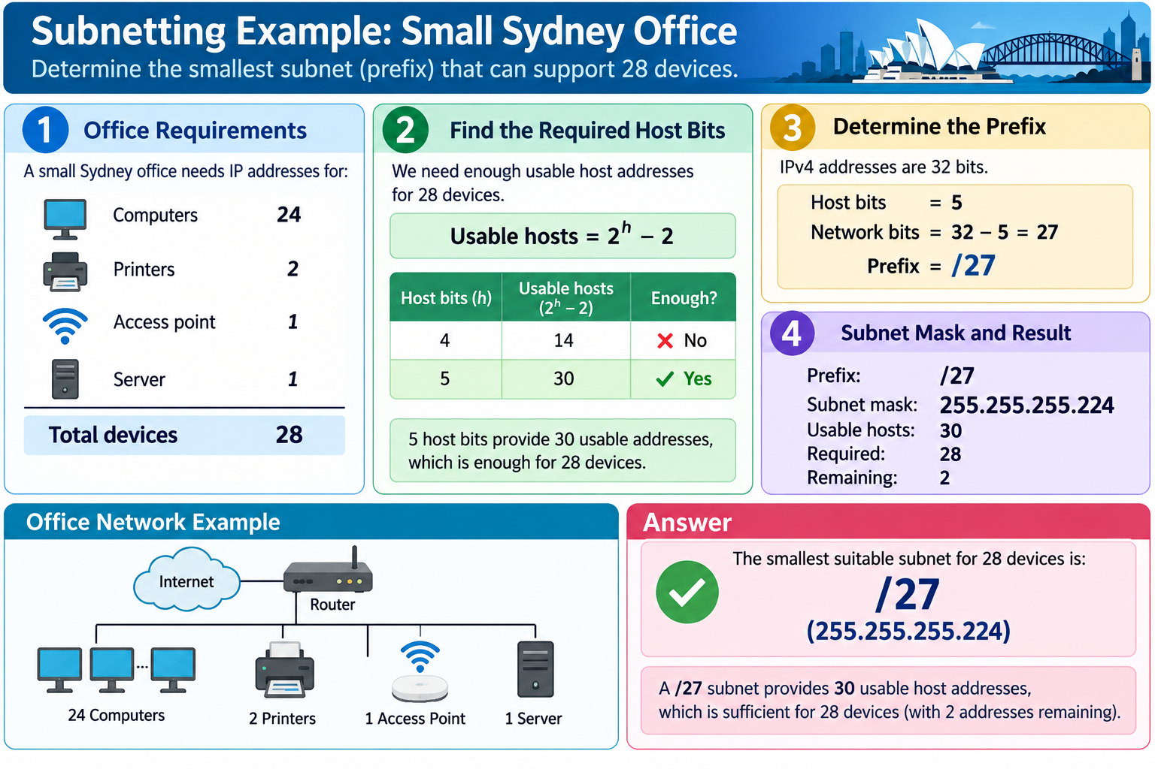
3
Presentation_ID
© 2008 Cisco Systems, Inc. All rights reserved.

Slide 36
Discussion: Allowing for Growth
A company currently has 28 devices.
Would /27 always be a good design?
Not necessarily.
/27 supports 30 usable hosts.
That leaves only:
2 spare addresses
A network designer may choose a larger subnet if significant growth is expected.
3
Presentation_ID
© 2008 Cisco Systems, Inc. All rights reserved.

Slide 37
Discussion: Allowing for Growth
Discussion question:
Why might /26 be better?
Answer:
It allows up to 62 usable hosts and provides room for growth.
3
Presentation_ID
© 2008 Cisco Systems, Inc. All rights reserved.

Slide 38
Subnet Size and Block Size
What Is Block Size?
Block size tells us where each subnet begins.
A useful shortcut is: Block size = 256 - interesting mask value
Example:
/27
Mask: 255.255.255.224
Therefore: 256 - 224 = 32
Subnets increase by 32.
3
Presentation_ID
© 2008 Cisco Systems, Inc. All rights reserved.

Slide 39
/27 Subnet Boundaries
Block size: 32
Therefore networks begin at:
0
32
64
96
128
160
192
224
So the /24 has been divided into 8 /27 subnets.
3
Presentation_ID
© 2008 Cisco Systems, Inc. All rights reserved.

Slide 40
Example /27
For: 192.168.1.75/27
Subnet ranges are:
0–31
32–63
64–95
96–127
...
75 falls inside:
64–95
Therefore:
Network: 192.168.1.64
Broadcast: 192.168.1.95
3
Presentation_ID
© 2008 Cisco Systems, Inc. All rights reserved.

Slide 41
Find the Host Range
Continuing:
Network: 192.168.1.64
Broadcast: 192.168.1.95
First usable host:
192.168.1.65
Last usable host:
192.168.1.94
3
Presentation_ID
© 2008 Cisco Systems, Inc. All rights reserved.

Slide 42
Discussion Practice
Given: 192.168.1.170/27
Which range contains 170?
128–159
160–191
192–223
Answer: 160–191
Therefore:
Network: 192.168.1.160
Broadcast: 192.168.1.191
Hosts: 192.168.1.161–190
3
Presentation_ID
© 2008 Cisco Systems, Inc. All rights reserved.

Slide 43
Finding the Network Address Using AND
Binary AND Operation
To calculate the network address exactly, computers use a binary AND operation.
Rules:
1 AND 1 = 1
1 AND 0 = 0
0 AND 1 = 0
0 AND 0 = 0
3
Presentation_ID
© 2008 Cisco Systems, Inc. All rights reserved.

Slide 44
Simple /24 Example
IP:
192.168.10.10
Mask:
255.255.255.0
AND result:
192.168.10.0
Therefore:
Network = 192.168.10.0
3
Presentation_ID
© 2008 Cisco Systems, Inc. All rights reserved.

Slide 45
Shortcut When Mask Contains 255 and 0
If a mask octet is: 255
the network result keeps the IP octet.
If the mask octet is: 0
the result becomes zero.
Example:
IP: 192.168.10.25
Mask: 255.255.255.0
Result: 192.168.10.0
3
Presentation_ID
© 2008 Cisco Systems, Inc. All rights reserved.

Slide 46
The Interesting Octet
You normally need detailed binary work only where the mask is neither: 255
nor: 0
Example:
IP: 172.30.239.145
Mask: 255.255.192.0
Only the third octet needs detailed calculation.
3
Presentation_ID
© 2008 Cisco Systems, Inc. All rights reserved.

Slide 47
Convert the Third Octet to Binary
IP third octet:
239
Binary:
11101111
Mask third octet:
192
Binary:
11000000
3
Presentation_ID
© 2008 Cisco Systems, Inc. All rights reserved.

Slide 48
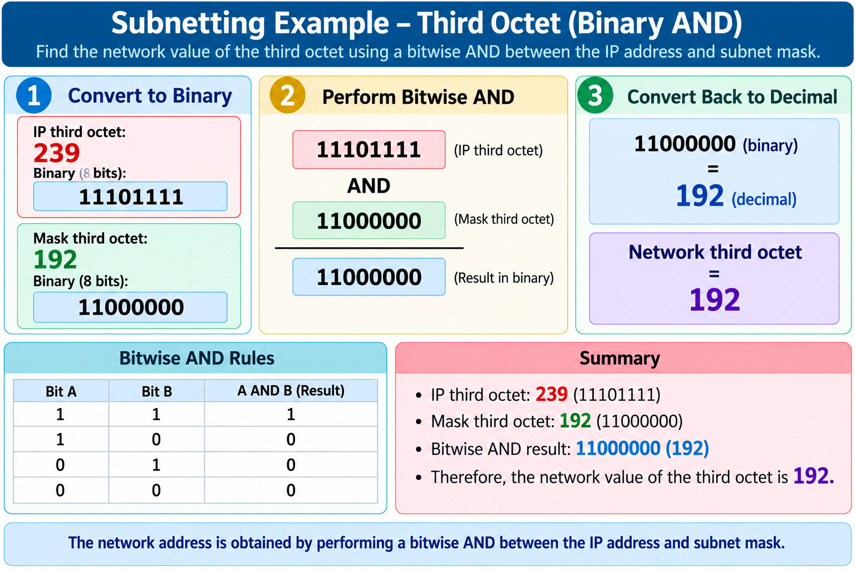
Perform AND
3
Presentation_ID
© 2008 Cisco Systems, Inc. All rights reserved.

Slide 49
Complete Network Address
Therefore:
IP: 172.30.239.145
Mask: 255.255.192.0
Network: 172.30.192.0
Because:
172 stays
30 stays
239 AND 192 = 192
fourth octet becomes 0
3
Presentation_ID
© 2008 Cisco Systems, Inc. All rights reserved.

Slide 50
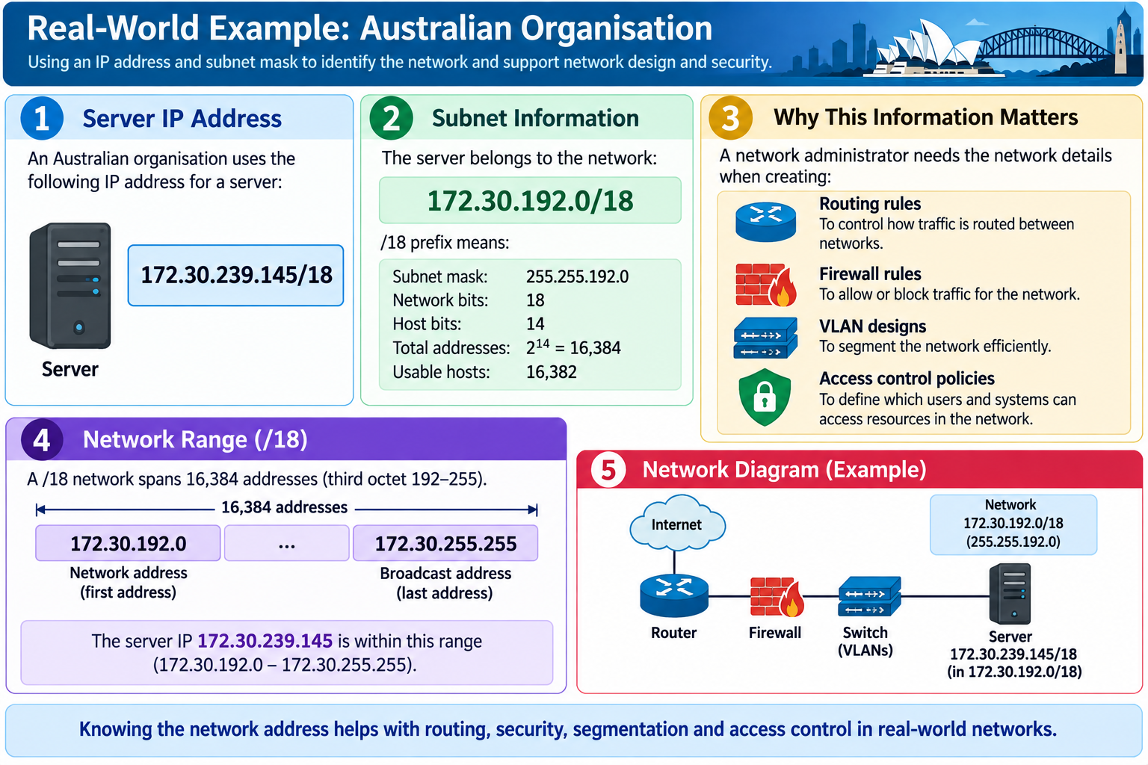
Australian Example: Enterprise Network
3
Presentation_ID
© 2008 Cisco Systems, Inc. All rights reserved.

Slide 51
Discussion Question
Why can't we identify the network from:
172.30.239.145
alone?
Answer:
Because we also need the subnet mask or prefix.
For example:
172.30.239.145/16
and:
172.30.239.145/18
belong to different subnet definitions.
3
Presentation_ID
© 2008 Cisco Systems, Inc. All rights reserved.

Slide 52
Host Bits and Number of Hosts
/18 Example
Mask:
255.255.192.0
Prefix:
/18
IPv4 has:
32 bits
Host bits:
32 - 18 = 14
3
Presentation_ID
© 2008 Cisco Systems, Inc. All rights reserved.

Slide 53
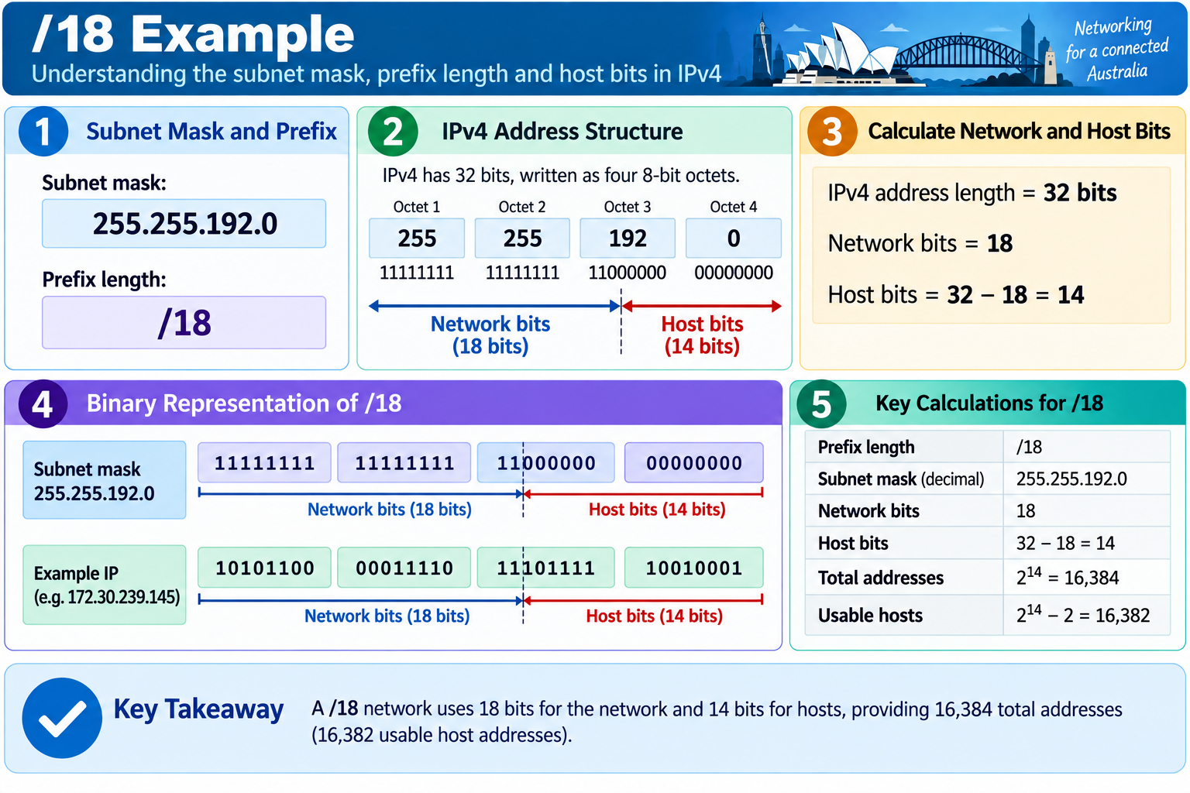
Hosts in a /18
3
Presentation_ID
© 2008 Cisco Systems, Inc. All rights reserved.

Slide 54
Quick Prefix Table
/24 → 8 host bits → 254 usable
/25 → 7 host bits → 126 usable
/26 → 6 host bits → 62 usable
/27 → 5 host bits → 30 usable
/28 → 4 host bits → 14 usable
/29 → 3 host bits → 6 usable
/30 → 2 host bits → 2 usable
This is very useful for AT2.
3
Presentation_ID
© 2008 Cisco Systems, Inc. All rights reserved.

Slide 55
Class Challenge
Which subnet is the smallest that supports 50 devices?
Try:
/27 → 30 usable
/26 → 62 usable
Answer:
/26
3
Presentation_ID
© 2008 Cisco Systems, Inc. All rights reserved.

Slide 56
Practice Set 1: Find Network and Broadcast
For each address:
Find the prefix
Find the block size
Identify the subnet containing the IP
Find network address
Find broadcast address
Find usable host range
Find usable hosts
3
Presentation_ID
© 2008 Cisco Systems, Inc. All rights reserved.

Slide 57
Practice 1
Given:
192.168.100.25/28
Before calculating, ask:
What is the block size?
Mask:
255.255.255.240
256 - 240 = 16
3
Presentation_ID
© 2008 Cisco Systems, Inc. All rights reserved.

Slide 58
Practice 1 Solution
Subnets:
0–15
16–31
32–47
...
25 is inside:
16–31
3
Presentation_ID
© 2008 Cisco Systems, Inc. All rights reserved.

Slide 59
Practice 1 Solution
Therefore:
Network: 192.168.100.16
First host: 192.168.100.17
Last host: 192.168.100.30
Broadcast: 192.168.100.31
Host bits: 4
Usable hosts: 14
3
Presentation_ID
© 2008 Cisco Systems, Inc. All rights reserved.

Slide 60
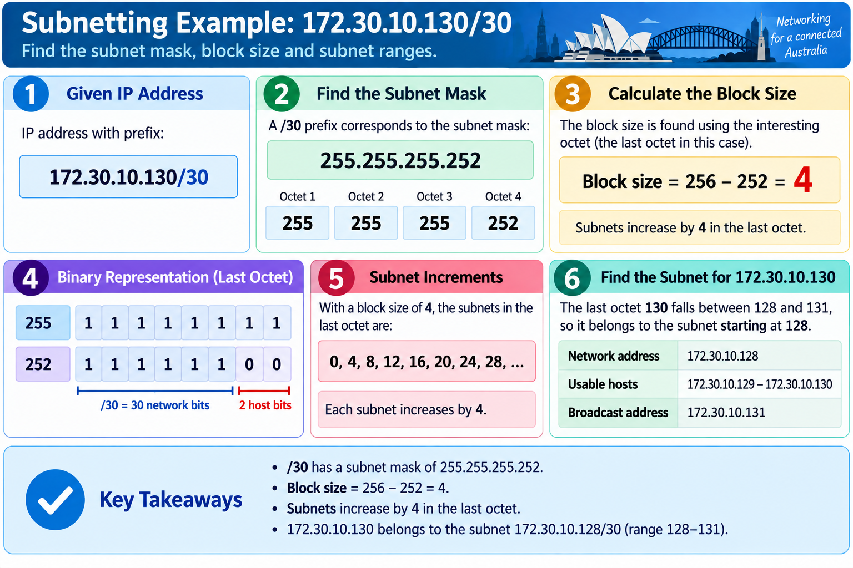
Practice 2
3
Presentation_ID
© 2008 Cisco Systems, Inc. All rights reserved.

Slide 61
Practice 2 Solution
Nearby ranges:
124–127
128–131
132–135
130 is inside:
128–131
Therefore:
Network: 172.30.10.128
First host: 172.30.10.129
Last host: 172.30.10.130
Broadcast: 172.30.10.131
Usable hosts: 2
3
Presentation_ID
© 2008 Cisco Systems, Inc. All rights reserved.

Slide 62
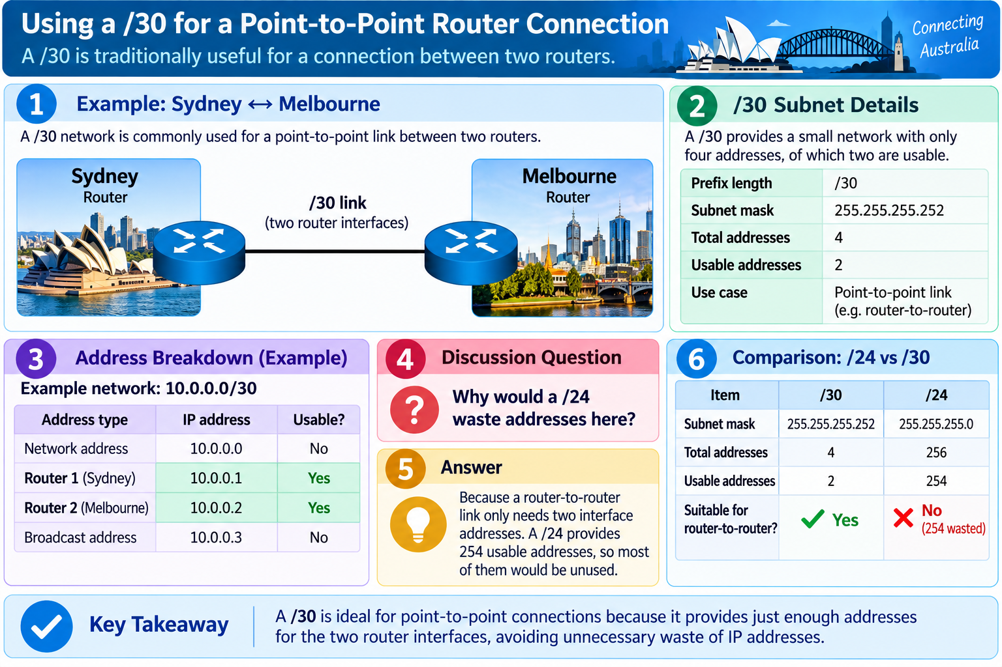
Australian Example: Point-to-Point Link
3
Presentation_ID
© 2008 Cisco Systems, Inc. All rights reserved.

Slide 63
Practice 3
Given:
10.1.113.75/19
Mask:
255.255.224.0
Interesting octet:
third octet
Block size:
256 - 224 = 32
3
Presentation_ID
© 2008 Cisco Systems, Inc. All rights reserved.

Slide 64
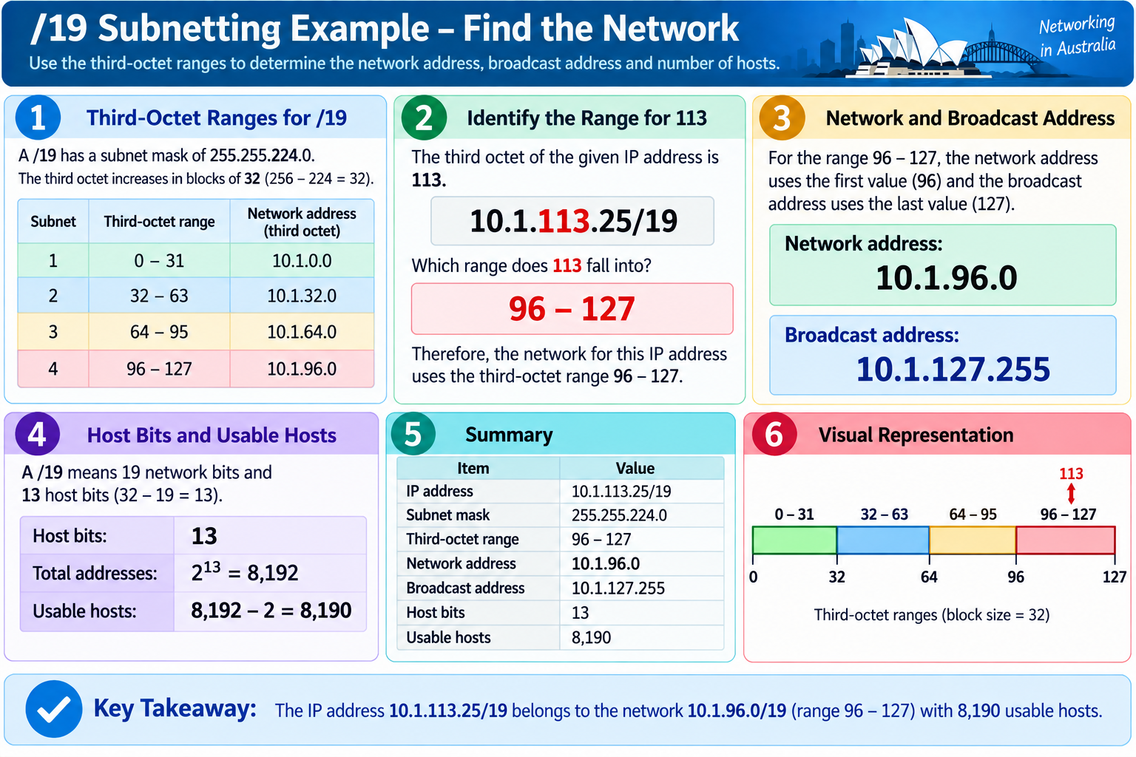
Practice 3 Solution
3
Presentation_ID
© 2008 Cisco Systems, Inc. All rights reserved.

Slide 65
Practice 4
Given:
198.133.219.250/24
Because /24 means:
255.255.255.0
Therefore:
Network: 198.133.219.0
Broadcast: 198.133.219.255
Host bits: 8
Usable hosts: 254
3
Presentation_ID
© 2008 Cisco Systems, Inc. All rights reserved.

Slide 66
Practice 5
Given: 128.107.14.191/22
Mask: 255.255.252.0
Block size in third octet: 256 - 252 = 4
Third-octet blocks:
0
4
8
12
16
...
14 belongs to:
12–15
3
Presentation_ID
© 2008 Cisco Systems, Inc. All rights reserved.

Slide 67
Practice 5 Solution
Therefore:
Network: 128.107.12.0
Broadcast: 128.107.15.255
Host bits: 10
Usable hosts: 1022
Discussion question:
What is the next subnet?
Answer:
128.107.16.0/22
3
Presentation_ID
© 2008 Cisco Systems, Inc. All rights reserved.

Slide 68
Practice 6
Given: 172.16.104.99/27
Mask: 255.255.255.224
Block size: 32
Ranges:
64–95
96–127
128–159
3
Presentation_ID
© 2008 Cisco Systems, Inc. All rights reserved.

Slide 69
Practice 6 Solution
99 is inside:
96–127
Therefore:
Network: 172.16.104.96
First host: 172.16.104.97
Last host: 172.16.104.126
Broadcast: 172.16.104.127
Usable hosts: 30
3
Presentation_ID
© 2008 Cisco Systems, Inc. All rights reserved.

Slide 70
Creating Subnets by Borrowing Bits
What Does “Borrow Bits” Mean?
Suppose the original network is:
192.168.1.0/24
A /24 has:
8 host bits
If we change it to /27:
27 - 24 = 3 borrowed bits
These borrowed bits create additional subnets
3
Presentation_ID
© 2008 Cisco Systems, Inc. All rights reserved.

Slide 71
Number of Created Subnets
Use:
2^s
where:
s = number of borrowed bits
Example:
3 borrowed bits
2³ = 8 subnets
3
Presentation_ID
© 2008 Cisco Systems, Inc. All rights reserved.

Slide 72
Example
Original: /24
New: /27
Borrowed bits: 27 - 24 = 3
Created subnets: 2³ = 8
Remaining host bits: 32 - 27 = 5
Usable hosts: 2⁵ - 2 = 30
3
Presentation_ID
© 2008 Cisco Systems, Inc. All rights reserved.

Slide 73
Class Question
We start with: 192.168.10.0/24
We need at least 6 subnets.
How many bits should we borrow?
Try:
2² = 4
2³ = 8
Answer:
3 bits
New prefix: /27
3
Presentation_ID
© 2008 Cisco Systems, Inc. All rights reserved.

Slide 74

Let’s Answer Your Questions
Canvas Inbox – For academic queries.
Email – For formal communication and attachments.
Canvas Discussion – For academic discussions and general queries.
Reminder – Please follow up if you do not receive a response within 3 business days.

Slide 75

Happy Learning and Bright Futures Ahead!
Dr. Farshid Keivanian
Stay Connected:
linkedin.com/in/farshid-keivanian
github.com/FarshidKeivanian
Education is the most powerful weapon you can use to change the world. — Nelson Mandela

